Slide 1
Day3-Datawarehouse

Slide 2
What is a Data Warehouse?
A Data Warehouse (DW) is a centralized repository that stores historical and integrated data from multiple sources, designed specifically for reporting and analysis (not for daily operations).

Slide 3
🧩 Core Characteristics of a Data Warehouse
Characteristic | Meaning
Subject-Oriented | Organized around key business areas (sales, customers, products).
Integrated | Combines data from various sources into a consistent format.
Non-Volatile | Data is stable; once entered, it’s not changed or deleted frequently.
Time-Variant | Stores historical data for trend analysis (data has timestamps).

Slide 4
Denormalization
Denormalization is a database optimization technique that involves adding redundant data to tables to improve read performance and avoid costly JOIN operations.
It is a strategy applied after a database has been normalized, and it trades off data integrity and write performance for faster query execution, making it suitable for analytical and reporting systems.

Slide 5
Use cases
OLAP and data warehousing: Denormalization is commonly used in data warehouses and analytical systems where the priority is fast querying and report generation, rather than frequent data updates.

Slide 6
Types of DWH tables
Dimension
Fact
Fact less Fact

Slide 7
Dimension Table
It is a DESCRIPTIVE attribute which talks about the describable information of any table/entity.
Example : Product Name/Category/type , customer location etc

Slide 8
Types of Dimension tables
1️⃣ Conformed Dimension
2️⃣ Role-Playing Dimension
3️⃣ Slowly Changing Dimension (SCD)
4️⃣ Junk Dimension
5️⃣ Degenerate Dimension
6️⃣ Snowflaked Dimension
7️⃣ Static Dimension
8️⃣ Inferred (Early-Arriving) Dimension
9️⃣ Outrigger Dimension
🔟 Mini Dimension

Slide 9
1️⃣ Conformed Dimension
Shared across multiple fact tables or data marts
Same meaning, same attributes everywhere
Enables cross-fact analysis
Example
Date_Dim used by Sales_Fact, Inventory_Fact
Customer_Dim used by both online & offline sales

Slide 10
2️⃣ Role-Playing Dimension
Same physical dimension used in different roles
Implemented by aliases or views
Example
Date_Dim acting as:
Order Date
Ship Date
Delivery Date
One table, many business meanings

Slide 11
3️⃣ Slowly Changing Dimension (SCD)
Handles changes in dimension attributes over time
🔹 Type 0 – Retain Original
No changes allowed
Example: Date of Birth
🔹 Type 1 – Overwrite
Old value replaced
No history
Example: Fixing spelling mistakes
🔹 Type 2 – Add New Row (Most used)
Full history maintained
Uses:
Surrogate Key
Start Date / End Date
Current Flag
🔹 Type 3 – Add New Column
Limited history
Example: old_city, current_city

Slide 12
4️⃣ Junk Dimension
Combines low-cardinality flags & indicators
Avoids too many tiny dimensions
Example
is_returned
payment_type
discount_flag
Improves schema cleanliness

Slide 13
5️⃣ Degenerate Dimension
Dimension attribute stored in fact table
No separate dimension table
High cardinality identifiers
Example
Order Number
Invoice ID
Transaction ID
Exists only in fact table

Slide 14
6️⃣ Snowflaked Dimension
Normalized dimension structure
Dimension split into sub-dimensions
Example
Product → Category → Department
Pros: Storage efficient Cons: Slower queries, complex joins Generally avoided in favor of star schema

Slide 15
7️⃣ Static Dimension
Rarely or never changes
Example
Country
Gender
Currency
Usually small and stable

Slide 16
8️⃣ Inferred (Early-Arriving) Dimension
Created before full details are available
Placeholder rows inserted
Updated later
Example
Sales fact arrives before customer master data
Used in real-time / streaming pipelines

Slide 17
9️⃣ Outrigger Dimension
Referenced by another dimension (not fact)
Dimension → Dimension relationship
Example
Customer_Dim → Geography_Dim
Sometimes used, but can complicate queries

Slide 18
🔟 Mini Dimension
Splits frequently changing attributes from a large dimension
Example
Customer core data (stable)
Customer behavior (age group, income band)
Reduces SCD Type-2 explosion

Slide 19
Dimension Type | Purpose
Conformed | Shared across facts
Role-Playing | Same dim, different roles
SCD | Track changes over time
Junk | Combine flags
Degenerate | Identifier only
Snowflake | Normalized dimension
Static | Rarely changes
Inferred | Early-arriving data
Outrigger | Dimension-to-dimension
Mini | Split volatile attributes

Slide 20
Fact Table
It is all about measurable information wrt any Dimension table/entity.
Example : Sales Fact table
Sales Qty, Total Units sold are measurable attribs.
Fact table holds two sets of Information:
1.Dimension keys
2.Measurable fields information

Slide 21
Fact less Fact table
A fact less fact table is a data warehouse table that records events or conditions without any numeric facts, containing only foreign keys to related dimensions.
It is used to track processes, model many-to-many relationships, and enable "negative analysis" where you look for what didn't happen.
Examples:
Invoice Number,Tracking student attendance or product promotions that did not sell.

Slide 22
🧠 Data Warehouse vs Database
Feature | Database (OLTP) | Data Warehouse (OLAP)
Purpose | Daily operations | Analytics & reporting
Data Type | Current, real-time | Historical, summarized
Users | Clerical users | Analysts, managers
Operations | Insert, Update, Delete | Read, Aggregate, Analyze
Design | Normalized (3NF) | Denormalized (Star/Snowflake schema)

Slide 23
🗃️ Common Data Warehouse Schemas
Schema Type | Description | Example
Star Schema | Central fact table linked to multiple dimension tables. | Sales fact linked to Product, Time, Customer.
Snowflake Schema | Dimensions are further normalized into sub-dimensions. | Product → Category → Brand.
Galaxy (Fact Constellation) | Multiple fact tables share dimension tables. | Sales & Inventory facts share Product dimension.

Slide 24
DWH vs Data Lake
Feature | Data Warehouse | Data Lake
Data Type | Structured | All (Structured, Semi, Unstructured)
Processing | ETL (before loading) | ELT (after loading)
Schema | Schema-on-Write | Schema-on-Read
Cost | High | Low
Users | Business Analysts | Data Scientists
Purpose | BI, Reporting | AI, ML, Big Data
Tools | Snowflake, Redshift, BigQuery | Hadoop, AWS S3, Databricks

Slide 25
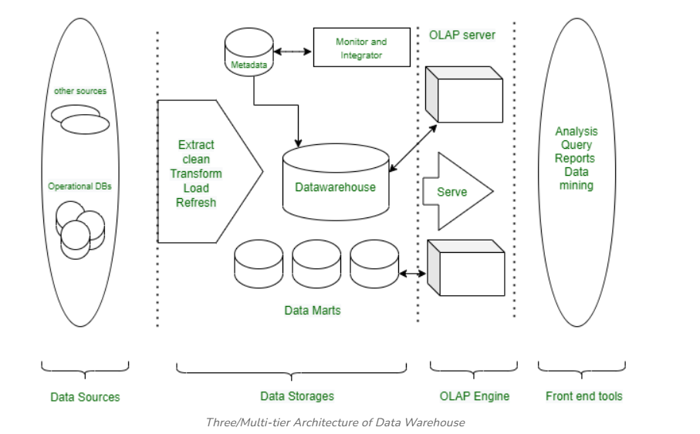
Data warehousing architecture

Slide 26
⚙️ Data Warehouse Architecture
1. Data Sources
Operational databases (OLTP)
Flat files, logs, ERP, CRM systems
2. Data Staging (ETL Layer)
Extract: Data is pulled from sources.
Transform: Cleaned and formatted.
Load: Loaded into the warehouse.
Tools: Informatica, Talend, AWS Glue, SSIS.
3. Data Storage (Warehouse Layer)
Central repository storing structured data.
Optimized for queries and analytics.
Databases: Snowflake, Amazon Redshift, Google BigQuery, Teradata.
4. Data Presentation Layer
Data Marts, OLAP cubes, BI tools (Power BI, Tableau, Looker).
Used for analytics and visualization.

Slide 27
Bottom Tier (Data Sources and Data Storage)
Middle Tier (OLAP Engine)
Top Tier (Front-End Tools)

Slide 28
Operational Data Store(ODS)

Slide 29
An Operational Data Store (ODS) is a type of database that collects and combines data from various sources.
It provides a unified view of this data and offers real-time or near-real-time updates. Unlike data warehouses that focus on storing historical data, an ODS is designed to handle current operational data and supports immediate decision-making by delivering up-to-date information.

Slide 30
An Operational Data Store (ODS) is a centralized database that integrates real-time data from various sources to support operational reporting and decision-making.
Unlike data warehouses that store historical data, an ODS focuses on providing current data for immediate use.
It acts as a bridge between transactional systems and data warehouses, ensuring data consistency and quick access to up-to-date information.
This allows organizations to make timely decisions based on the latest data available

Slide 31
Key features of an ODS :
Real-time Data Integration: Data is collected and stored with the help of EDWs, and data is ready for usage immediately after its creation in the source systems.
Data Consolidation: The process where information from one source is combined with information from other sources to give a single output.
Low Latency: It is used and intended for easy reach of data and minimum time for accessing information.
Data Cleansing: Aids in data cleansing and data preparation to make it easier to work with for transformation and analysis.

Slide 32
Feature | Operational Data Store (ODS) | Data Warehouse (DW)
Primary Purpose | Support daily operations and provide current data | Support analytical processing and decision-making
Data Freshness | Near real-time or real-time | Historical, with periodic updates
Data Storage Duration | Short-term (days to weeks) | Long-term (months to years)
Data Integration | Data is integrated and consistent from various sources | Data is integrated, cleaned, and transformed
Data Usage | Operational reporting, quick queries | Complex queries, analytics, trend analysis
Data Structure | Typically normalized | Often de-normalized (star/snowflake schema)
Query Performance | Optimized for high volume of simple queries | Optimized for complex, analytical
User Access | Operational staff, line managers | Data analysts, business intelligence (BI) users
Update Frequency | Frequently updated (real-time or near real-time) | Less frequent updates (daily, weekly, monthly)
Data Scope | Current operational data | Comprehensive historical data
Granularity | More granular, focusing on individual transactions | Aggregated data, focusing on summaries and trends
Scalability | May require quick scaling due to real-time nature | Typically designed for large-scale, stable environments
Examples | Transactional data, current customer orders | Historical sales data, customer purchase history

Slide 33
What is Data Mart?
A data mart is a specialized subset of a data warehouse focused on a specific functional area or department within an organization.
It provides a simplified and targeted view of data, addressing specific reporting and analytical needs.
Data marts are smaller in scale and scope, typically holding relevant data for a specific group of users, such as sales, marketing, or finance.
They are organized around specific subjects, such as sales, customer data, or product information, and are structured, transformed, and optimized for efficient querying and analysis within the domain.

Slide 34
Types of Data Mart
Independent Data Mart
Dependent Data Mart
Hybrid Data Mart

Slide 35
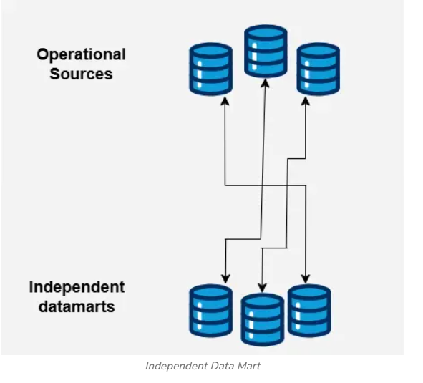
1. Independent Data Mart
An independent data mart is created and maintained separately from the data warehouse. It is created to satisfy the particular needs of a specific business unit or department.
Independent data marts are typically smaller in size and more rapidly and readily set up.
They offer flexibility and agility since they are not constrained by the challenges of the centralized data warehouse. Nevertheless, data redundancy and inconsistency may result if it is replicated over several different data marts.

Slide 36
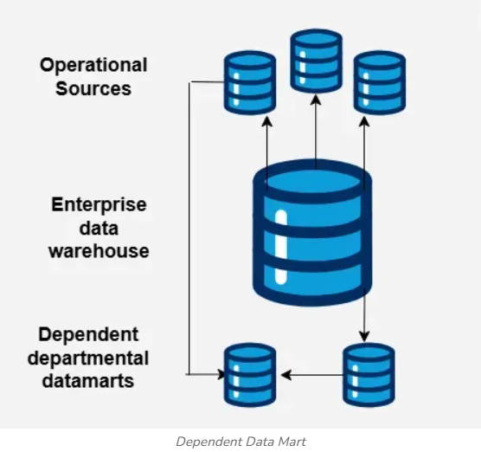
2. Dependent Data Mart
A dependent data mart is generated right out of a data warehouse.
It takes some of the data from the data warehouse and arranges it to meet the needs of a specific industry. Dependent data marts, which profit from the data integration, data quality, and consistency provided by the data warehouse, allow for the centralization and preservation of all data in a single source of truth.
They are often developed to serve particular reporting and analytical needs, and they are frequently updated from the data warehouse.
Dependent data marts offer data consistency and prevent data duplication because they rely on the data warehouse as their main source of data.

Slide 37
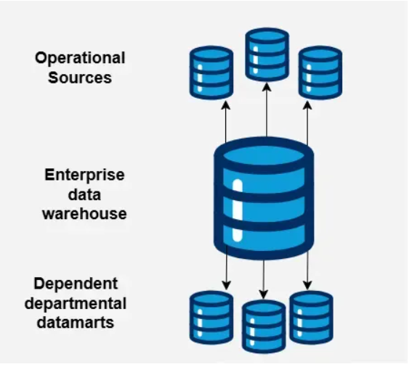
3. Hybrid Data Mart
Both independent and dependent data mart components can be found in a hybrid data mart.
As well as combining additional data sources particular to a given business unit or department, it makes use of the centralized data warehouse for the integration and consistency of the core data.
By offering flexibility and agility for department-specific needs while keeping the integrity and consistency of shared data from the data warehouse, hybrid data marts offer the benefits of both strategies.
This strategy creates a balance between localized data management and centralized data management.

